Slide 1
Congregational Meeting
Consistory Recommendation for Transfer to the PCA
FAITH REFORMED CHURH
April 15, 2018

Slide 2
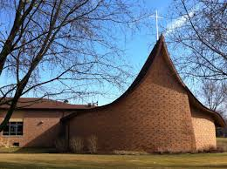
OPENING PRAYER

Slide 3
Why Are We Here Today?
Rich Navis

Slide 4
Why Are We Here Today?
A growing divergence in the RCA’s interpretation of scripture versus Faith Reformed Church’s
While FRC has remained consistent in its doctrinal perspectives since its organization in 1964, the RCA has not
Faith Reformed Church sponsored several overtures (proposals/motions) to the General Synod in efforts to reform the RCA
The Consistory’s desire is to partner with like-minded churches and focus our resources and energy locally
The Consistory agreed to enter a Denomination Assessment Process, and the Great Consistory supported the decision

Slide 5
Denomination Assessment Overview
An Exploratory Team was formed to do research on behalf of the Consistory
Denominations Researched:
The Reformed Church in America (RCA)
The United Reformed Church in North America (URCNA)
The Orthodox Presbyterian Church (OPC)
The Presbyterian Church in America (PCA)
The Evangelical Free Church in America (EFCA)
In Dec 2017, the Consistory narrowed its consideration of potential alternative denominations to the PCA

Slide 6
Denomination Assessment Overview
Two Pastors from the Wisconsin Presbytery of the PCA met with the Consistory at the Dec 2017 Consistory meeting
Two RCA leaders, including Tony DeLaRosa, Interim Classis Leader of the Wisconsin Classis, met with the Great Consistory at the Jan 2018 Consistory meeting
Five Consistory members attended a video interview at Gibbsville Reformed Church, Jan 2018, with Rev. Bob Bouwer, co-founder of the Gospel Alliance

Slide 7
Why Are We Here Today?
“We the Consistory believe we have done our due diligence in assessing the RCA and other denominations. After years of discussion and prayers, at our February 2018 Consistory meeting, we voted unanimously to recommend to you, the congregation, that we request a transfer of our membership to the Presbyterian Church in America (PCA).”

Slide 8
Differences Between…
Faith Reformed Church and the RCA
Jon Damkot

Slide 9
Changes in the RCA
The RCA no longer holds true to our biblical and doctrinal convictions. Here are five significant positions that have changed:
1. Our Standards of Unity
2. Who is admitted to the Offices of the Church
Removal of the Conscience Clauses
3. Who is Admitted to the Lord’s Table
4. The Formula of Agreement
5. Confusion on Biblical Sexuality

Slide 10
Changes in the RCA 1) Our Standards of Unity

Slide 11
1) Our Standards of Unity
Traditionally:
3 Creeds: Apostle, Nicene, Athanasian
The RCA has upheld the 3 Forms of Unity
The Heidelberg Catechism
The Belgic Confession
The Canons of the Synod of Dort
Today:
In 2010, the RCA General Synod added a 4th confessional statement: The Belhar Confession

Slide 12
1) Our Standards of Unity
Concerns about the Belhar Confession
It is not a doctrinal standard
It is open to interpretation
Unity, justice & reconciliation
Potentially justifies falsehood & condemns orthodoxy
Prioritizes a false unity over truth

Slide 13
Changes in the RCA 2) Who is admitted to the Offices of the Church

Slide 14
2) Who is admitted to the Offices of the Church
Traditionally:
In the RCA, when Faith Reformed was organized, Ministers of Word and Sacrament, Elders and Deacons were men
Today:
In 1972 the RCA opened the offices of Elder and Deacon to women, and women were accepted for ordination as ministers of Word and Sacrament in 1979

Slide 15
2) Who is admitted to the Offices of the Church
Removal of the Conscience Clauses
1980: Conscience Clauses - Ministers shall not be pressured in such a way as to lead either one who supports or one who opposes, on scriptural grounds, the ordination of women to church offices to offend against one’s conscience; nor shall any minister be penalized for conscientious objection to or support of the ordination of women to church offices; nor shall any minister obstruct by unconstitutional means the election, ordination, or installation of a woman to church offices.
2013: The General Synod ratified the removal of the conscience clauses.

Slide 16
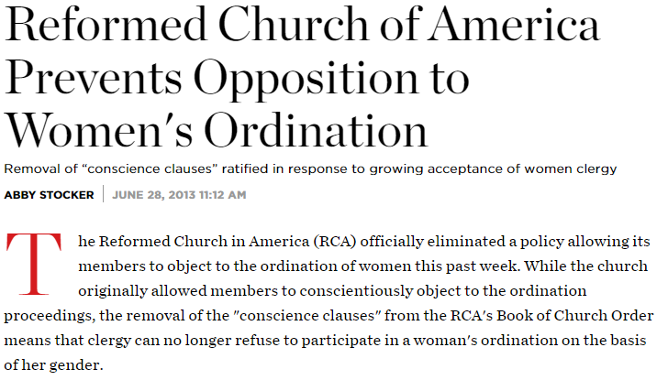

Slide 17
2) Who is admitted to the Offices of the Church
Consequences of the Removal of the Conscience Clauses
Complementarians are now subject to discipline
Complementarians can no longer uphold their membership vows in good conscience
Complementarians are deterred from joining or staying in the RCA

Slide 18
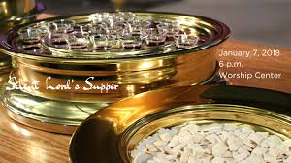
Changes in the RCA 3) Who is Admitted to the Lord’s Supper

Slide 19
3) Who is admitted to the Lord’s Supper
Traditionally:
The Heidelberg Catechism and the Belgic Confession state that the Lord’s Supper is for all believers
Today:
The RCA Website says that “baptized children are welcome at the Lord’s Table because they are members of the church….”

Slide 20
3) Who is admitted to the Lord’s Supper
Why is this a concern?
It undermines the nature and meaning of the Lord’s Supper
It confuses the distinction between Baptism and the Lord’s Supper
It contradicts our Confessional Standards

Slide 21
Changes in the RCA 4) A Formula of Agreement

Slide 22
4) A Formula of Agreement
Today:
1997: A Formula of Agreement – The RCA now has full communion with the Presbyterian Church USA (PCUSA), the Evangelical Lutheran Church in America (ECLA) and the United Church of Christ (UCC).

Slide 23
4) A Formula of Agreement
Why is this a concern?
Each of these denominations approves of and endorses homosexuality and same-sex marriage.
A Formula of Agreement allows for the “free exchange” of pastors between these denominations regardless of their individual ordination credentials

Slide 24
Changes in the RCA 5) Confusion on Biblical Sexuality

Slide 25
5) Confusion on Biblical Sexuality
On paper, the RCA holds to an orthodox view of gender and marriage.
In 2017, the General Synod approved a recommendation stating that the Heidelberg Catechism’s text on “unchastity” includes a prohibition against homosexuality, thus constitutionalizing this view.
In practice, such affirmations of the orthodox view have been ignored with regularity.
Classes are responsible for upholding the constitution, and many do not.

Slide 27
5) Confusion on Biblical Sexuality
Room for All (RfA) – established in 2005
RfA’s Vision and Mission:
Our vision and mission statements indicate our commitment to the welcome and affirmation of lesbian, gay, bisexual, transgender and queer people and their allies and advocate for a radically inclusive welcome and affirmation of the full spectrum of God’s people in all aspects of our congregational and denominational ministries.
224 RCA pastors have signed an RfA pledge
9 General Synod Professors (past or current) are RfA members

Slide 28
Active Homosexual Clergy
“An RCA classis in New Jersey in September embraced the ordination of the Rev. Ursula Cargill, a gay woman credentialed in the Universal Fellowship of Metropolitan Community Churches.”
--mlive.com, 2015

Slide 29
Active Homosexual Clergy
2016: The Classis of Holland, MI ordained an openly homosexual man as Minister of the Word and Sacrament
2017: The Classis of New York ordained an openly homosexual man as Minister of Word and Sacrament

Slide 30
5) Confusion on Biblical Sexuality
Why is this a concern?
It contradicts God’s Word
It justifies sin, and prevents people from finding salvation from sin through the Gospel of Jesus Christ.
1 John 1:8-9 – If we say we have no sin, we deceive ourselves, and the truth is not in us. If we confess our sins, He is faithful and just to forgive us our sins and to cleanse us from all unrighteousness.

Slide 31
Changes in the RCA The effect on Seminaries

Slide 32
Changes in the RCA - Seminaries
RCA Seminary teaching reflects and perpetuates the existing issues in the RCA
They do not teach the orthodox view on the inspiration of scripture (verbal plenary).
They do not teach the orthodox view of hermeneutics or the interpretation of scripture.
They do not require adherence to the Standards of Unity.
They do not teach complementarianism.
Some General Synod professors are RfA members.

Slide 33
Changes in the RCA – Seminaries The Impact….
The pool of candidates that will be acceptable to Faith Reformed Church is shallow and quickly drying up
Conservative, evangelical, and reformed men are seeking ordination in other denominations (like the PCA) because they do not want to be deemed a “poor fit,” and because the RCA is seen as a “sinking ship.”
We will one day need to find and hire the next Pastor, we will have more sound and qualified candidates that fit our preferred profile within the PCA

Slide 34
Changes in the RCA
Conclusion: the RCA has drifted from its convictions from 1964 when Faith Reformed Church was established.
Faith Reformed Church has held to its original convictions. As a result, there is significant divergence between current convictions of the RCA and FRC.

Slide 35
Changes in the RCA
The main issue: the interpretation of scripture
The orthodox understanding of the Bible is that the Bible is the primary source of truth through which we correctly understand all other sources of truth. (The Bible interprets experience.)
The progressive understanding of the Bible is that the Bible is one among many sources of truth, and that other sources of truth help us to interpret the Bible’s truths. (Experience interprets the Bible.)
The impression is that the primary issues are the changes listed above, while in reality these are merely symptoms of a greater issue: how we interpret scripture.

Slide 36
Stay and Fight Jeff Risseeuw

Slide 37
You May be Thinking…
“The issues that you have been discussing with respect to the RCA are not impacting Faith Reformed Church, why do we have to make a change?”
“It will never happen to us, we have a long tradition”
“I want to stay and fight, why are we giving up?

Slide 38
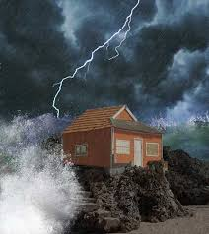
Matthew 7:25 - “The rain came down, the streams rose, and the winds blew and beat against that house; yet it did not fall, because it had its foundation on the rock.”
Without a strong foundation the house will crumble!
Maybe not next year or the year after, but what happens in 5 or 10 years

Slide 39
The Gospel Alliance – Who are they?
Formed in 2017 by three RCA pastors of large congregations
A movement of covenant partners who are engaging leaders and communities with the message of Jesus Christ to make more and stronger disciples
Publicly Stated Goals:
To plant enough new, evangelical churches to shift the balance of power in the RCA denomination
Influence the Western Theological Seminary to encourage changes in seminary leadership and faculty
Not Publicly Stated Goals:
To gather sufficient critical mass of membership to have influence on the denomination. There are over 500 individuals and 100 churches who have already signed onto the Gospel Alliance to date.

Slide 40
The Gospel Alliance - Concerns
A similar effort/group in 2006 called the, RCA Integrity, was formed with the same intentions, it did not change the ongoing drift within the RCA and disbanded in 2012
There is a lack of short-term strategy for strategically affecting the RCA. Even if the balance of power can be tipped, it will be a political victory and does not resolve the doctrinal divisions within
The Gospel Alliance is exploring the option of starting a new denomination if they are unable to influence the RCA.
What would that look like? How long would it take? And, How would their doctrinal perspectives compare to FRC?
All unknowns at this time

Slide 41
If we stay and fight questions?
What would we be fighting for?
Who will lead the fight?
Who will do the fighting, both from Faith Reformed and from the denomination?
Why do we think things would be different this time?
What will it take to win?
What will winning look like?
We believe that winning would look something like the PCA

Slide 42
Fighting Not Our Best Option
We prefer to invest our energy in advancing the Gospel and spreading God’s word
We are not convinced that fighting (trying to influence the RCA) will reap any benefits – too much to overcome
The fight to restore the RCA to its historic, doctrinal roots will be costly and time consuming. It will require total commitment from those who are willing to engage in the battle.
Those who enter half-heartedly will be likely to flee or surrender before victory could be won.

Slide 43
Overview of the PCA

Slide 44
Presbyterian Timeline
OPC
1936
EPC
1981
ECO
2012
PCA
1973
Mainline Denomination
Presbyterian Church in the United States 1861
1st Split
2nd Split
3rd Split
4th Split
Most Conservative
Most Liberal
Calvary Orthodox Presbyterian Church, Cedar Grove
Presbyterian Church in America – the denomination we are considering
First Presbyterian Church
Cedar Grove
First Presbyterian Church
Oostburg

Slide 45
Who is the PCA?
Organized in 1973, it separated from the Presbyterian Church in the United States (Southern) in opposition to their theological liberalism
The PCA has a strong commitment to evangelism, missionary work at home and abroad, and to Christian education
From its beginning, the PCA has determined its purpose to be “faithful to the Scriptures, true to the reformed faith, and obedient to the Great Commission”
One of the fastest growing denominations in the US, with over 1,700 churches and missions, RCA currently at 875
Its Mission to the World has 519 career missionaries in almost 60 nations, 169 two-year missionaries, and over 6,500 short term missionaries
Its offices are located in Lawrenceville, GA

Slide 46
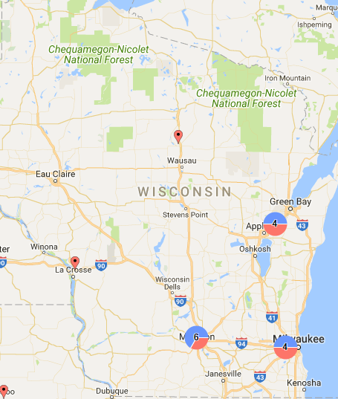
Wisconsin PCA Churches
16 in Total
6 in Madison area
4 in Milwaukee area
2 in Fox Valley
2 in Green Bay area
1 Merrill
1 La Crosse
Oldest Merrill, 1936
Closest - Oshkosh
Goal to establish 16 more in the next 10 years

Slide 47
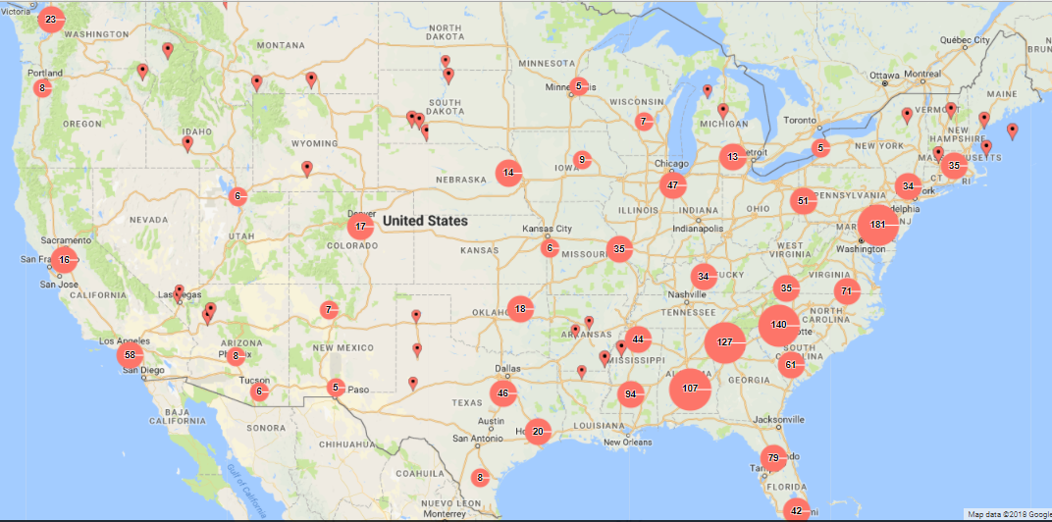
PCA Churches Across the U.S.
16

Slide 48
Why is the PCA the best fit?
It’s a Reformed Denomination
Same form of church government
Denomination accountability and discipline procedures
Our values and commitments would not change
Our outward appearance and practices would not change
Our worship and ministries would not change
Our process of calling Pastors would not change

Slide 49
What Would Change?

Slide 50
Beneath the surface what would change in the PCA for FRC?
Denomination Governance
Church Governance
Denomination Costs
Reformed Confessions

Slide 51
Denominational Governance
RCA
PCA
Consistory
Classis
General Synod
Regional Synod
Session
Presbytery
General Assembly
Top Heavy
Grass Roots
BECOMES
4 Levels
3 Levels

Slide 52
Denominational Governance Notes
The Session is comprised of its Teaching Elder (Pastor) and Ruling Elders
The offices of the church are open to men only
Teaching elder reports to the Presbytery at least once per year
The Presbytery consists of all its Teaching Elders, and two (or more) Ruling Elders from each church within the Presbytery
Delegates to the General Assembly are: all Teaching Elders, and two (or more) Ruling Elders from each church within the denomination

Slide 53
Church’s Governance
RCA
PCA
Consistory
E1
E2
E3
E4
E5
E6
D2
D3
D4
D5
D6
D1
Pastor
Session
RE2
RE3
RE4
RE5
RE6
TE1
RE1
6 Elders / 6 Deacons / Pastor
6 Ruling Elders + 1 Teaching Elder

Slide 54
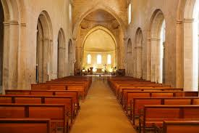
Church Governance Notes
Elders RULE, Deacons SERVE
Length of service defined by church by-laws
Deacons are under the supervision of the Session
The Deacons should meet jointly with the Session at least quarterly and among themselves at least quarterly
The officers of the Elders continues to be a President, Vice President, and Clerk
The officers of the Board of Deacons are: chair, secretary, and treasurer of the deacons (required in title only)
Nomination process is the same however:
Women would not appear on the ballot
Nominees are interviewed by the Session

Slide 55
Denomination Cost Notes
RCA
PCA
Annual assessment (dues) based on the number of active members ($19,182 for 2018)
Money is used at the discretion of the RCA
Funding activities of which we do NOT support, i.e. Facebook, webpages to links like the Room for All movement
The annual Wisconsin Classis budget for the RCA will reach $600,000 in 2018
No annual dues or payments required
Able to direct payments to specific permanent committees of the General Assembly
The annual budget for the Wisconsin Presbytery is currently $125,000 - primarily for church planting support

Slide 56
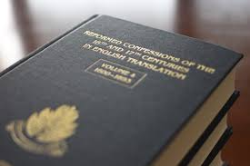
Reformed Confessions
RCA
PCA
Belgic Confession
Canons of Dort
Heidelberg Catechism
Belhar Confession
Added in 2010
Westminster Confession
Westminster Shorter Catechism
Westminster Larger Catechism
The Westminster teachings are in harmony with the Heidelberg Catechism, therefore, we will continue to teach and learn from it

Slide 57
What Will Not Change?
We will continue to:
Have the same Sunday service format
To be strong in missionary work
To have the freedom to continue joint youth ministry with the churches in Cedar Grove
Keep our existing committees
Kris can continue to be our financial treasurer
We will own our property and land
Our annual budget creation and approval process
It is unclear if our church name will have to change
However, Grace Reformed Church in Fond du Lac was allowed to leave without having to change its name

Slide 58
Will the PCA Become the RCA?

Slide 59
Will the PCA Eventually Succumb to the Same Issues as the RCA?
There are never any guarantees, however:
All officers (Teaching Elders (pastors), Ruling Elders, and Deacons) are required to confess a belief in the inerrancy, sufficiency, and authority of the Word
Within the PCA, Presbyteries are able to hold one another accountable, not true in the RCA
Where the Scriptures are believed, trusted, and seen as ultimate authority, the trajectory for a denomination can be expected to be quite different than what we have experienced in the RCA

Slide 60
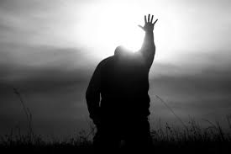
PCA Scripture Confessions
The PCA confesses to believe in:
the inerrancy of Scripture:
The belief that Scripture is without error in fact and doctrine
the sufficiency of Scripture:
The belief that all that is needed to glorify God and enjoy him is taught in the Word
the authority of Scripture:
It is the final arbiter of truth in the church and all that we do must be conformed to it.

Slide 61
Next Steps?

Slide 62
Next Steps?
Handouts available at the back table for you to take and read through
You can submit questions to any consistory member – Several meetings scheduled in May to discuss further
Congregation Q&A meeting with Chris Vogel, PCA representative – April 29th
Congregation Vote – Jun 10th
The consistory will review/discuss the results and share with the congregation. We will require a strong majority in order to move forward.

Slide 63
Testimonials

