Slide 2
Denomination Assessment Process:
Congregational Education

Slide 3
SESSION ONE:
What Has Changed
in the RCA

Slide 4
Our Confessional Standards
Have Changed

Slide 5
Historically, the RCA has had
Three Forms of Unity:
1) The Heidelberg Catechism
2) The Belgic Confession
3) The Canons of the Synod of Dort

Slide 6
In 2010, the RCA General Synod added
a fourth confessional statement entitled:
The Belhar Confession

Slide 7
About the Belhar:
The History of the Belhar
The Themes of the Belhar
Its Adoption by the RCA

Slide 8
Concerns about the Belhar:
1) What the Belhar Doesn’t Say:
a) It is not a doctrinal standard.
b) It cannot stand alone.
c) It is a ministry statement.

Slide 9
Concerns about the Belhar:
2) What the Belhar Might Say:
a) Lack of theological precision.
b) Open to interpretation.

Slide 10
Concerns about the Belhar:
3) What the Belhar Does Say:
a) Liberation theology.
b) Politicizes the church’s mission.

Slide 11
Concerns about the Belhar:
3) What the Belhar Does Say:
c) Inverts the nature of unity.
d) Prioritizes unity over truth.

Slide 12
Implications of the Belhar:
1) Standardizes bad theology.
2) Unstandardizes the Standards.
3) Potentially justifies falsehood.

Slide 13
Implications of the Belhar:
4) Potentially condemns orthodoxy.
5) Obstructs dissent and discipline.
6) Deters signing the Declaration.

Slide 14
Who Is Admitted to
the Offices of the Church
Has Changed

Slide 15
A Brief History of
Women’s Ordination
in the RCA

Slide 16
Whether or not you agree with
Women’s Ordination,
this is a significant change
in the theology and polity
of the RCA.

Slide 17
Who Is Admitted to
the Lord’s Table
Has Changed

Slide 18
The Meaning of the Sacraments
The Belgic Confession – Article 33
For they are visible signs and seals of something internal and invisible, by means of which God works in us through the power of the Holy Spirit. So they are not empty and hollow signs to fool and deceive us

Slide 19
The Meaning of the Sacraments
The Belgic Confession – Article 33
For they are visible signs and seals of something internal and invisible, by means of which God works in us through the power of the Holy Spirit. So they are not empty and hollow signs to fool and deceive us

Slide 20
For Whom Is The Lord’s Supper
The Belgic Confession – Article 35
We believe and confess that our Savior Jesus Christ has ordained and instituted the sacrament of the Holy Supper to nourish and sustain those who are already regenerated and ingrafted into his family, which is his church.

Slide 21
For Whom Is The Lord’s Supper
The Belgic Confession – Article 35
We believe and confess that our Savior Jesus Christ has ordained and instituted the sacrament of the Holy Supper to nourish and sustain those who are already regenerated and ingrafted into his family, which is his church.

Slide 22
For Whom Is The Lord’s Supper
The Heidelberg Catechism – Q&A 75
Q. How does the holy supper remind and assure you that you share in Christ's one sacrifice on the cross and in all his benefits? A. In this way: Christ has commanded me and all believers to eat this broken bread and to drink this cup in remembrance of him.

Slide 23
For Whom Is The Lord’s Supper
The Heidelberg Catechism – Q&A 75
Q. How does the holy supper remind and assure you that you share in Christ's one sacrifice on the cross and in all his benefits? A. In this way: Christ has commanded me and all believers to eat this broken bread and to drink this cup in remembrance of him.

Slide 24
For Whom Is The Lord’s Supper
The Heidelberg Catechism – Q&A 76
Q. What does it mean to eat the crucified body of Christ and to drink his poured-out blood? A. It means to accept with a believing heart the entire suffering and death of Christ and thereby to receive forgiveness of sins and eternal life.

Slide 25
For Whom Is The Lord’s Supper
The Heidelberg Catechism – Q&A 76
Q. What does it mean to eat the crucified body of Christ and to drink his poured-out blood? A. It means to accept with a believing heart the entire suffering and death of Christ and thereby to receive forgiveness of sins and eternal life.

Slide 26
Coming To The Table
RCA Website
In the Reformed Church in America baptized children are welcome at the Lord’s Table because they are members of the church, recipients of God’s grace, and able to offer their love and thankfulness to Jesus...

Slide 27
Coming To The Table
RCA Website
Thus, baptized children should be encouraged to participate in the Supper of grace. The Lord’s Supper is a means of grace that nourishes faith. Children can experience the richness of the Lord’s Supper long before they can verbalize its meaning.

Slide 28
Why Is This a Concern:
• It confuses the distinction between
Baptism and the Lord’s Supper.
• It contradicts our Confessional Standards.

Slide 29
Why Is This a Concern:
• It undermines the nature and meaning
of the Lord’s Supper.
• It offers false hope.

Slide 30
A History Lesson:
The Half-Way Covenant

Slide 31
With Whom We Have
Full Communion
Has Changed

Slide 32
A Formula of Agreement
1997

Slide 33
What Is A Formula of Agreement?
The document declares that a "full communion" exists between the Evangelical Lutheran Church in America and three churches of the Reformed tradition--the Presbyterian Church U.S.A., the United Church of Christ, and the Reformed Church in America…

Slide 34
What Is A Formula of Agreement?
"Full communion" is not a plan to merge;
the four denominations continue to maintain their distinctive traditions and identities.
Rather, the four agree to recognize the validity of each other's baptism, encourage the sharing of Holy Communion, and permit ministers from one denomination to serve in the other denominations…

Slide 35
What Is A Formula of Agreement?
The pivotal concept in developing the Formula was that while differences between faith traditions must be acknowledged, even to the point of failing to reconcile, these differences are not church dividing so long as "the core traditions of the churches belong together within the one, holy, catholic, and apostolic church."

Slide 36
What Is A Formula of Agreement?
A Formula of Agreement provides for “full communion” between its member denominations, recognizing “each other as churches in which the gospel is rightly preached…according to the Word of God.”

Slide 37
What Is A Formula of Agreement?
A Formula of Agreement provides for “full communion” between its member denominations, recognizing “each other as churches in which the gospel is rightly preached…according to the Word of God.”

Slide 38
The Problem With The FOA:
The “gospel unity” on which the FOA was founded no longer exists. Each of the other three denominations have approved same-sex marriage and the ordination of those committed to a LGBTQ lifestyle. Thus, the gospel is NOT “rightly preached according to the Word of God.”

Slide 39
The Problem With The FOA:
This makes the “free exchange” of ministers with the other three denominations inappropriate and unacceptable.
Note: This does not mean ministers from the other denominations should not serve in the RCA, but that they should be examined rather than allowed to freely come into the RCA.

Slide 40
The Conscience Clauses
Have Been Removed
From The
Book of Church Order

Slide 41
A Brief History of
The Conscience Clauses

Slide 42
What Are The Conscience Clauses?
Ministers shall not be pressured in such a way as to lead either one who supports or one who opposes, on scriptural grounds, the ordination of women to church offices to offend against one's conscience; nor shall any minister be penalized for conscientious objection to or support of the ordination of women to church offices; nor shall any minister obstruct by unconstitutional means the election, ordination, or installation of a woman to church offices.

Slide 43
Consequences of the Removal:
1) Complementarians are now subject to discipline.
2) Complementarians can no longer uphold their
membership vows in good conscience.
3) Complementarians are deterred from joining
or staying in the RCA.
NOTE: Complementarian typically equals conservative.

Slide 44
Review of the Changes:
1) Our Confessional Standards have changed.
2) Admission to the offices of the church has changed.
3) Admission to the Lord’s Table has changed.
4) Whom we have full communion with has changed.
5) The Conscience Clauses have been removed.

Slide 45
Questions
and
Discussion

Slide 47
SESSION TWO:
Hermeneutics and
Homosexuality
in the RCA

Slide 48
What in the world is
Hermeneutics?

Slide 49
Biblical hermeneutics
is the study of
the principles and methods
of interpreting the text
of the Bible.

Slide 50
Why is hermeneutics
relevant?

Slide 51
A Local Example:
One text
Two sermons
Two different conclusions

Slide 52
Hermeneutics
is the root of the divisions
in the American Church,
including the RCA.

Slide 53
Everyone who reads
the Bible
has a hermeneutic.

Slide 54
Some examples of
Biblical hermeneutics:

Slide 55
“This is what the Bible means to me.”

Slide 56
“Well, that’s just
your interpretation.”

Slide 57
“The Bible can be made to say anything you want.”

Slide 58
“No one can really understand the true meaning of the Bible.”

Slide 59
Everyone who reads
the Bible
has a hermeneutic.

Slide 60
The question is:
Is your hermeneutic
a good one
or a bad one?

Slide 61
Principles of Interpretation
based on an article by Dr. James David
Bible.org, November 6, 2013

Slide 62
Principle #1
Interpretation must be based on
the author’s intention of meaning
and not the reader’s interpretation.
A text means
what the author intended it to mean.

Slide 63
Principle #2
Interpretations must be done
in the context of the passage.
Illustration: “It was a ball.”
Context determines meaning!

Slide 64
Principle #3
Interpret the Bible literally (or normally)
allowing for normal use of figurative language.
Take the plain meaning of the text
at face value.
When literal doesn’t make sense,
you probably have a figure of speech.

Slide 65
Principle #4
Use the Bible to help interpret itself.
The Bible will not contradict itself.
Use the New Testament
to help interpret the Old Testament.

Slide 66
Principle #5
Interpretation must be distinguished
from application.
There is only one historic interpretation,
but there can be multiple applications
of the passage’s principle(s).

Slide 67
Principle #6
Be sensitive to distinctions between
Israel and the Church,
and Old Covenant and New Covenant eras/requirements.
Not everything in the OT is
automatically transferable to the Church.

Slide 68
Principle #7
Be sensitive to the type of literature you are in.
The Bible contains many different types of literature: law, narrative, wisdom, poetry, gospel, parable, epistle, and apocalyptic. Each of these types of literature has specific features that must be considered when interpreting a text.

Slide 69
The Point:
There are established hermeneutical principles
that enable us to accurately
interpret of the Bible
and discern the intent of the author.

Slide 70
The Point:
There are established hermeneutical principles
that enable us to accurately
interpret of the Bible
and discern the intent of the author.

Slide 71
The Sufficiency of Scripture

Slide 72
What do we mean by
the Sufficiency of Scripture?
The Scriptures are sufficient
to equip us
for a life of faith and service.

Slide 73
Does that mean the Bible contains
everything we need to know?
No. There are many sources of knowledge not contained in the Bible.

Slide 74
A major spiritual battle ground today
is based upon the relationship between
the Bible and other sources of knowledge.

Slide 75
The orthodox understanding of the Bible is that
the Bible is the primary source of truth
through which we correctly understand
all other sources of truth.
All other sources of truth
will be consistent with
the truth of the Bible.

Slide 76
Bible
Science
History
Math
Experience

Slide 77
The progressive understanding of the Bible
is that the Bible is
one among many sources of truth,
and that other sources of truth
help us to interpret the Bible’s truths.

Slide 78
Bible
Science
History
Math
Experience

Slide 79
An illustration of sufficiency
in the context of Homosexuality
Experience interprets the Bible.

Slide 80
In other words, in the progressive’s view,
the Bible alone
is not sufficient to equip us
for life and service.

Slide 81
A Simplified Explanation
of the Different Views
on the Sufficiency of Scripture:
In the orthodox view,
Scripture interprets culture.
In the progressive view,
culture interprets Scripture.

Slide 82
Application:
In the past 50 years,
new interpretations of the Bible
have developed in the areas of:
The Role of Women in the Church
Gender and Marriage

Slide 83
Application:
Has the Bible changed
in the past 50 years?
Has our culture changed
in the past 50 years?

Slide 84
Application:
Then, in regards to these new interpretations,
do you think:
the Bible is interpreting our culture
or our culture is interpreting the Bible?
Answer:
Culture is interpreting the Bible!

Slide 85
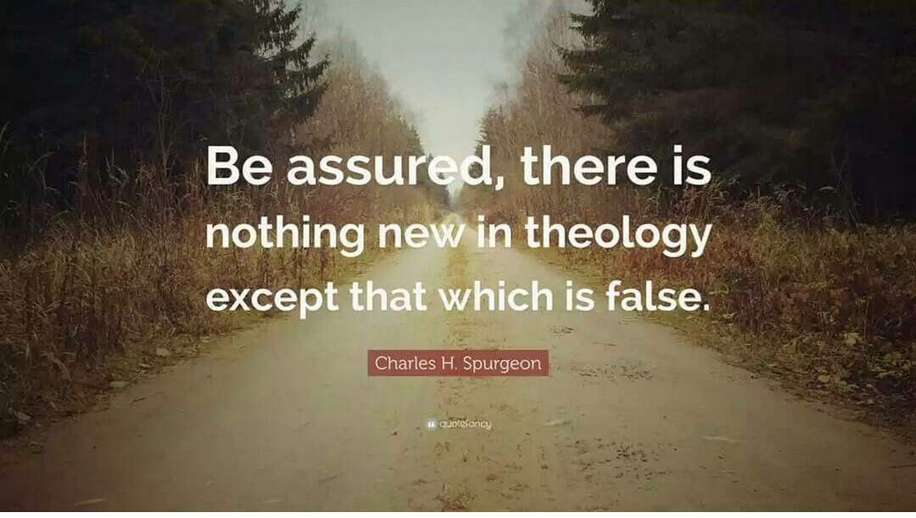

Slide 86
Questions
and
Discussion
Note: We still have more to cover today!

Slide 87
A Brief History of the
Subject of Homosexuality
in the RCA

Slide 88
1978
Heterosexuality is not only normal;
it is normative.
Homosexual acts are contrary to the will of God for human sexuality.

Slide 89
1990
To adopt as the position of the RCA
that the practicing homosexual lifestyle
is contrary to scripture,
while at the same encouraging love
and sensitivity towards such persons
as fellow human beings.

Slide 90
2005
The Rev. Dr. Norman Kansfield was convicted
by the General Synod of violating his vows
as a General Synod Professor of Theology
and as a Minister of Word and Sacrament.

Slide 91
2005
The General Synod accepted as new business:
“Engage in Dialogue
or Hold Us Accountable, Too.”

Slide 92
“Engage in Dialogue or Hold Us Accountable, Too.”
We believe that committed same-sex relationships are not sinful,
but rather a blessing from God.

Slide 93
“Engage in Dialogue or Hold Us Accountable, Too.”
We believe that the Reformed Church in America ought to confess its sinfulness in adhering for too long to an oppressive position on homosexuality and ought to seek the forgiveness of its lesbian, gay, bi-sexual and transgendered brothers and sisters.

Slide 94
2005
“Room for All” (RfA) was founded.

Slide 95
Room for All’s Vision and Mission:
Compelled by the inclusive love of God revealed in Jesus Christ and empowered by the Spirit, Room for All is a community of Christ-followers in the Reformed Church in America.

Slide 96
Room for All’s Vision and Mission:
Our vision and mission statements indicate our commitment to the welcome and affirmation of lesbian, gay, bisexual, transgender and queer people and their allies...

Slide 97
Room for All’s Vision and Mission:
and advocate for a radically inclusive welcome and affirmation of the full spectrum of God’s people in all aspects of our congregational and denominational ministries.

Slide 98
Room for All Membership:
34 Member congregations
224 RCA pastors who have signed a pledge
9 General Synod Professors (past or current)
14-21 RCA Staff members (past or current)

Slide 99
A Pop Quiz
Which one of the following three people
is the one who has made a vow as a RCA minister to:
Accept the Scriptures as the only rule of faith and life
and to
Accept the Standards as historic and faithful
witnesses to the Word of God?

Slide 100
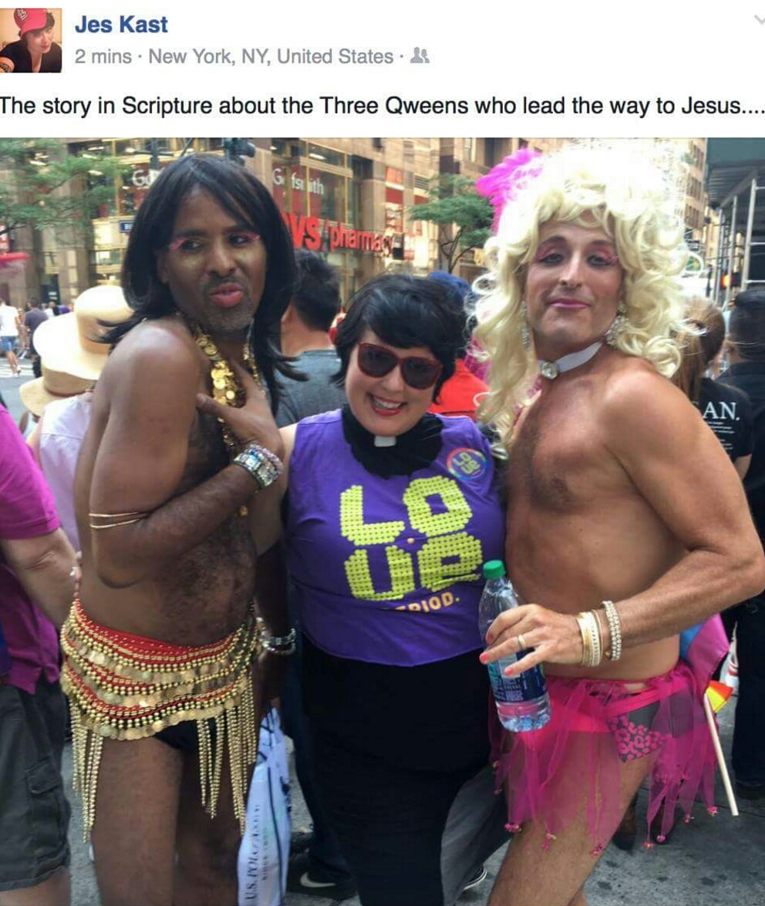

Slide 102
Room for All National Conferences

Slide 103
Regional Conferences and Resources
Room for All hosts regional conferences in West Michigan,
New York, New Jersey, and Pella, IA.
They also produce resources specifically for RCA congregations.

Slide 104
Room for All Kids Camp
Sponsored by RCA churches

Slide 105
2012
…the General Synod reaffirms our official position that homosexual behavior is a sin according to the Holy Scriptures…

Slide 106
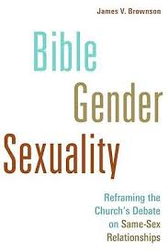
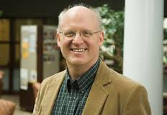
Western Seminary Professor Advocates for Full Inclusion
2014
Dr. James V. Brownson wrote the above book advocating
for full inclusion of homosexuals in the life of the church.

Slide 107
2015
The General Synod, in judicial session, approved the reception of an openly homosexual female pastor, who was ordained in a Formula of Agreement denomination.

Slide 108
2016
A Special Council was held to devise a constitutional resolution to the RCA position
on gender and marriage.
The Council failed to reach a resolution,
and passed the issue on to the General Synod.

Slide 109
2016
The Classis of Holland ordained
an openly homosexual man
as Minister of the Word and Sacrament.

Slide 110
2016
The General Synod approved and sent two proposed constitutional changes to the classes, each would affirm the orthodox view of marriage as between one man and one woman.

Slide 112
2017
The Classis of New York ordained
an openly homosexual man
as Minister of the Word and Sacrament.

Slide 113
2017
General Synod’s two proposed constitutional changes that would have affirmed the orthodox view of marriage as between one man and one woman failed to receive the necessary approval by 2/3s of the classes.

Slide 114
Questions
and
Discussion

Slide 116
SESSION THREE:
Unity, Disunity, and Polity
in the RCA

Slide 117
The Biblical View
of the
Nature of Unity

Slide 118
An Overview of John 17
John 17:8
For I gave them the words you gave me and they accepted them. They knew with certainty that I came from you, and they believed that you sent me.

Slide 119
An Overview of John 17
John 17:8
For I gave them the words you gave me and they accepted them. They knew with certainty that I came from you, and they believed that you sent me.

Slide 120
An Overview of John 17
John 17:8
For I gave them the words you gave me and they accepted them. They knew with certainty that I came from you, and they believed that you sent me.

Slide 121
An Overview of John 17
John 17:11
I will remain in the world no longer, but they are still in the world, and I am coming to you. Holy Father, protect them by the power of your name…so that they may be one as we are one.

Slide 122
An Overview of John 17
John 17:11
I will remain in the world no longer, but they are still in the world, and I am coming to you. Holy Father, protect them by the power of your name…so that they may be one as we are one.

Slide 123
An Overview of John 17
John 17:17
Sanctify them by the truth; your word is truth.

Slide 124
An Overview of John 17
John 17:17
Sanctify them by the truth; your word is truth.

Slide 125
An Overview of John 17
John 17:20-21a
My prayer is not for them alone. I pray also for those who will believe in me through their message, that all of them may be one, Father, just as you are in me and I am in you.

Slide 126
An Overview of John 17
John 17:20-21a
My prayer is not for them alone. I pray also for those who will believe in me through their message, that all of them may be one, Father, just as you are in me and I am in you.

Slide 127
An Overview of John 17
John 17:20-21a
My prayer is not for them alone. I pray also for those who will believe in me through their message, that all of them may be one, Father, just as you are in me and I am in you.

Slide 128
An Overview of John 17
John 17:22-23a
I have given them the glory that you gave me, that they may be one as we are one: I in them and you in me. May they be brought to complete unity to let the world know that you sent me and have loved them even as you have loved me.

Slide 129
An Overview of John 17
John 17:22-23a
I have given them the glory that you gave me, that they may be one as we are one: I in them and you in me. May they be brought to complete unity to let the world know that you sent me and have loved them even as you have loved me.

Slide 130
An Overview of John 17
John 17:22-23a
I have given them the glory that you gave me, that they may be one as we are one: I in them and you in me. May they be brought to complete unity to let the world know that you sent me and have loved them even as you have loved me.

Slide 131
An Overview of John 17
The unity for which Jesus prays is agreement about the nature of His relationship with God the Father as revealed in the truth of His Word.

Slide 132
New Testament Passages About Unity
Romans 16:17-18
I appeal to you, brothers, to watch out for those who cause divisions and create obstacles contrary to the doctrine that you have been taught; avoid them.

Slide 133
New Testament Passages About Unity
1 Corinthians 1:10
I appeal to you, brothers, by the name of our Lord Jesus Christ, that all of you agree, and that there be no divisions among you, but that you be united in the same mind and the same judgment.

Slide 134
New Testament Passages About Unity
1 Corinthians 1:10
I appeal to you, brothers, by the name of our Lord Jesus Christ, that all of you agree, and that there be no divisions among you, but that you be united in the same mind and the same judgment.

Slide 135
The Biblical View of Unity
Unity is the by-product or outcome that flows naturally from having common convictions about what is true.

Slide 136
The Biblical View of Disunity
Disunity is the by-product or outcome that flows naturally from NOT having common convictions about what is true.

Slide 137
Is Disunity in the Church Always Wrong?
1 Corinthians 11:18-19
For, in the first place, when you come together as a church, I hear that there are divisions among you. And I believe it in part, for there must be factions among you in order that those who are genuine among you may be recognized.

Slide 138
Is Disunity in the Church Always Wrong?
1 Corinthians 11:18-19
For, in the first place, when you come together as a church, I hear that there are divisions among you. And I believe it in part, for there must be factions among you in order that those who are genuine among you may be recognized.

Slide 139
Is Disunity in the Church Always Wrong?
1 Corinthians 11:18-19
For, in the first place, when you come together as a church, I hear that there are divisions among you. And I believe it in part, for there must be factions among you in order that those who are genuine among you may be recognized.

Slide 140
The Progressive’s View
of the
Nature of Unity

Slide 141
THE PROGRESSIVE VIEW OF UNITY
Unity is accepting everyone without judgment.
Disunity is judging, condemning, rejecting, or not being tolerant and accepting of everyone.
The progressive’s “motto” for unity is:
room for all.

Slide 142
THE PROGRESSIVE VIEW OF UNITY
Unity is not the consequence of having
common convictions.
It is a goal to be attained through tolerance and the avoidance of reconciling differences.

Slide 143
THE DANGER OF PROGRESSIVE VIEW
If unity is a goal, we run the risk of doing whatever is necessary to keep the peace.

Slide 144
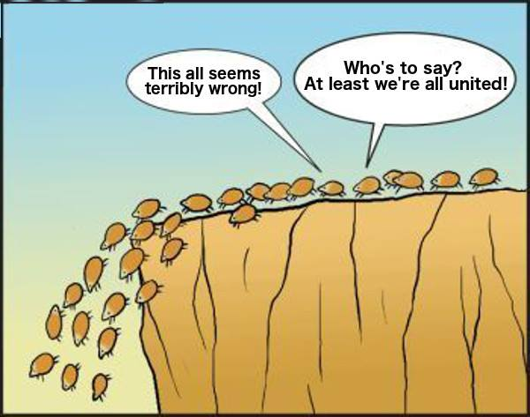

Slide 145
THE DANGER OF PROGRESSIVE VIEW
If unity is the goal, we will:
• minimize differences
• ignore issues
• shun confrontation
• neglect discipline
• compromise truth for the sake of unity

Slide 146
THE DANGER OF PROGRESSIVE VIEW
The problem with the “room for all” progressive view is that it is contrary to the biblical view of unity. The can be no unity without common convictions about what is true. The inevitable consequence of the progressive view is disunity and division.

Slide 147
THE DANGER OF PROGRESSIVE VIEW
The progressive’s disingenuousness call for unity:
1) The progressives are the current source of disunity in the church through their advocacy of different doctrines.

Slide 148
THE DANGER OF PROGRESSIVE VIEW
The progressive’s disingenuousness call for unity:
2) They will advocate for unity while they are in the minority. However, once they are in the majority, they will switch their advocacy to purity. An example of this is their handling of the issue of women’s ordination in the RCA.

Slide 149
Questions
and
Discussion
Note: We still have more to cover today!

Slide 150
DISUNITY BY DEFINITION
Orthodox and Progressive Christians
use the same vocabulary,
but have different dictionaries.

Slide 151
DISUNITY BY DEFINITION
Orthodox: the Word of God
The Bible is the Word of God: inerrant, inspired, revelation of God’s truth.
Progressive: the Word of God
The Bible contains the Word of God.

Slide 152
DISUNITY BY DEFINITION
Orthodox: the Word of God
The Bible is the Word of God: inerrant, inspired, revelation of God’s truth.
Progressive: the Word of God
The Bible contains the Word of God.

Slide 153
DISUNITY BY DEFINITION
Orthodox: Love
Love is confronting sin for the sake of deliverance.
Progressive: Love
Love is accepting people as they are
without judgment or condemnation.

Slide 154
DISUNITY BY DEFINITION
Orthodox: Sin
Homosexuality is a sin that requires repentance.
Progressive: Sin
Homosexuality is a blessing from God
that deserves acceptance and affirmation.

Slide 155
DISUNITY BY DEFINITION
Orthodox: The Gospel
The gospel is Jesus’ atoning death on the cross for our sin and the gift of His righteousness.
Progressive: The Gospel
The gospel is loving, accepting, and affirming all people as they are.

Slide 156
DISUNITY BY DEFINITION
Orthodox: The Sufficiency of Scripture
The Bible is completely sufficient in its teaching about faith and life.
Progressive: The Sufficiency of Scripture
The Bible is one source of truth by which we learn about faith and life.

Slide 157
DISUNITY BY DEFINITION
Orthodox: The Perspicuity (Clarity) of Scripture
The essential truths of the Bible can be clearly understood by all without special training.
Progressive: The Perspicuity (Clarity) of Scripture
Due to time and culture, one can never know for sure what the Bible really meant to say.

Slide 158
DISUNITY BY DEFINITION
Orthodox: Reformed and Always Reforming
Our lives are always changing as they are being transformed by the truth of Scripture.
Progressive: Reformed and Always Reforming
Our view of the Bible and what it teaches must always be changing.

Slide 159
Questions
and
Discussion
Note: We still have more to cover today!

Slide 160
Since They Don’t Agree
With the Majority of the RCA,
Why Don’t the Progressives
Just Go Away?

Slide 161
1) DIFFERENT WORLDVIEWS
Orthodox: Change comes from the inside out
Progressive: Change comes from the outside in.

Slide 162
2) DIFFERENT VIEWS OF THE GOSPEL
NOTE: We should accept and respect that all within the RCA are well-intentioned people, who believe they are faithfully interpreting God’s Word, modeling the life of Jesus, are empowered by the Holy Spirit, and seeking to live out the gospel as they understand it.

Slide 163
2) DIFFERENT VIEWS OF THE GOSPEL
For the progressives, it is a matter of the gospel for them to love and accept all people as they are. Their fight for homosexuality and same-sex marriage is a matter of gospel justice. They see themselves as justified in striving to change the “unbiblical and unjust” perspectives of those who disagree with them. It is their gospel mission.

Slide 164
2) DIFFERENT VIEWS OF THE GOSPEL
A video example of the progressive’s view:
Listen for how the GOSPEL is described.
Listen for the issue of JUSTICE.
Listen for the nature of the MISSION
for which they fight.

Slide 166
Why Aren’t People
Being Disciplined?
The Problem with Polity

Slide 167
The Structure of the RCA

Slide 168
General Synod

Slide 169
General Synod

Slide 170
General Synod

Slide 171
General Synod

Slide 172
General Synod

Slide 173
General Synod

Slide 174
General Synod
Professors

Slide 175
A PERSONAL PERSPECTIVE
The real problem in the RCA is not the progressives and their views. The real problem has been the orthodox or conservatives who have failed to stand up for biblical truth, acted congregationally, tolerated heresy, and neglected to exercise church discipline.

Slide 176
Questions
and
Discussion

Slide 178
SESSION FOUR:
What We Want in
a Denomination

Slide 179
A Pop Quiz

Slide 180
1) What is hermeneutics?
What is the goal of good hermeneutics?
What is the orthodox interpretation of
“Reformed and Always Reforming?”
What is the progressive interpretation of
“Reformed and Always Reforming?”
What is the orthodox understanding
of unity?
What is the progressive understanding
of unity?

Slide 181
A Review of
General Synod 2017

Slide 182
The Problem with Polity:
Part 2

Slide 183
What is the Authority of General Synod?
2/3’s Classis Majority and
Representation Inequities

Slide 184
What We Want in
a Denomination

Slide 185
An open discussion among attendees.
Presentation of the Consistory list of
Denomination Expectations.

